Slide 1
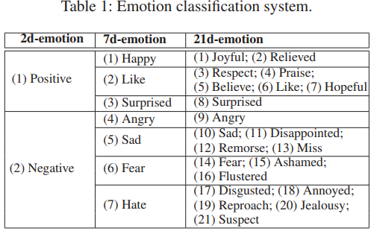
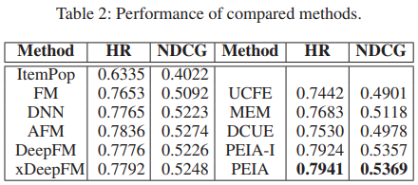
PEIA: Personality and Emotion Integrated Attentive Model for Music Recommendation on Social Media Platforms Published at: AAAI-20 Student: Avineet Kumar Singh
Illustration
Evaluation
Discussion
The good thing about this paper was the way it utilized user interactions on social media keeping time and location in mind.
Leaves an unanswered question: How this model can be implemented on music apps?
Motivation
Rapid expansion of digital music formats requires efficient recommendation system.
These systems require to understand users’ personality and emotion in a long-term and short-term manner.
Prior Art
most common approaches are collaborative filtering (CF) and content-based methods (CBM).
wide variety of methods have been developed.
(1) factorization machines (FM) (2) DNN (3) DeepFM (4) xDeepFM (5) AFM (6) ACF (7) DIN
Problem
Earlier works adopted limited information.
systematical modeling of user is especially deficient.
Solution
In PEIA model, rich social media data is fully utilized for elaborate user modeling from perspectives of both personality and emotion, while music content is also incorporated to enhance music recommendation.

